Slide 1
Hour 2
Writing Your First Program

Slide 2
What You Need To Write Programs
Netbeans IDE
Source code (Text) editor
Simple text files – can open in Notepad
Color highlights

Slide 3
Creating a Project for This Class
We need to create a project for this class
All our programs will go into this project
Open Netbeans
Select File > New Project
Category: Java
Project: Java Application
Click Next
Project Name: Java24
Deselect “Create Main Class”
Click Finish

Slide 4
Beginning the “Hello World” Program
Our first program will simply print “Hello World” on the screen
Add a new program to the Java24 Project
File > New File
Project: Java24
Categories: Java
File Types: Empty Java File
Click Next
Name and Location
Name: HelloWorld
Package: <blank>
Note created file name (HelloWorld.java)
Click Finish

Slide 5
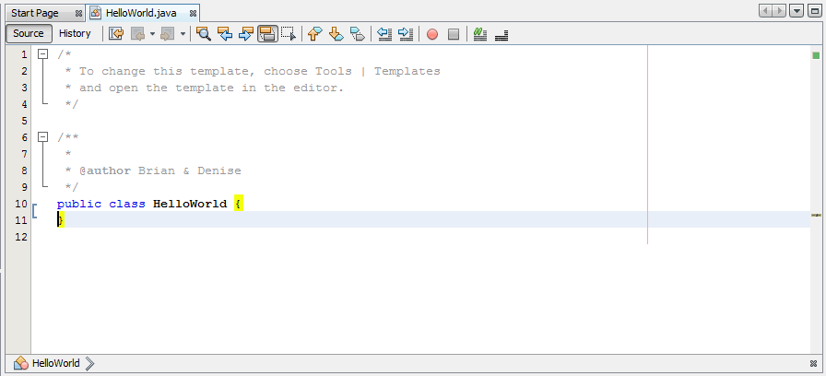
The class Statement
Gives your class (program) a name: HelloWorld
In Java class name always matches the file name

Slide 6
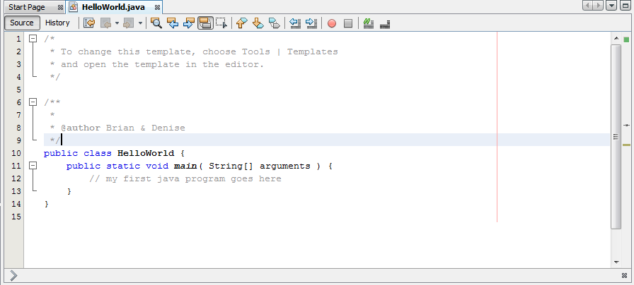
What the main Statement Does
The main part of the program begins here
Programs always start with main
Exceptions: applets and servlets
The main part of the program begins here
Programs always start with main

Slide 7
Those Squiggly Bracket Marks
The main part of the program begins here
Programs always start with main
Exceptions: applets and servlets
{ and } enclose blocks
Class Block
Main Function block
Blocks inside of blocks - Nesting

Slide 8
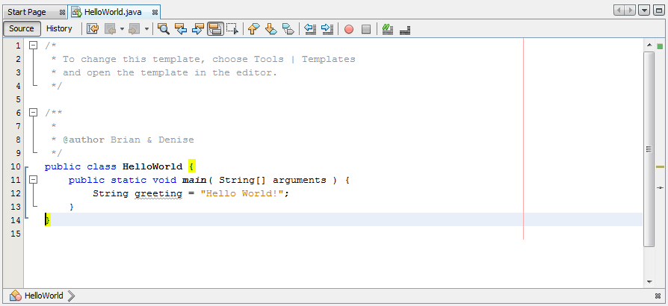
Storing Information in a Variable
Variable: storage place in computer memory:
Numbers, characters, text, true/false
Can change
Type of variable:
String
Content of variable:
Hello World
Statement ends with ;

Slide 9
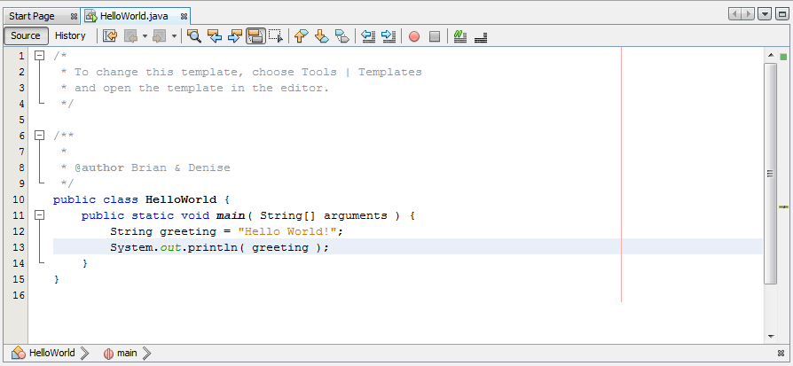
Displaying the Contents of a Variable
Print the greeting to the console
Save the file: File > Save

Slide 10
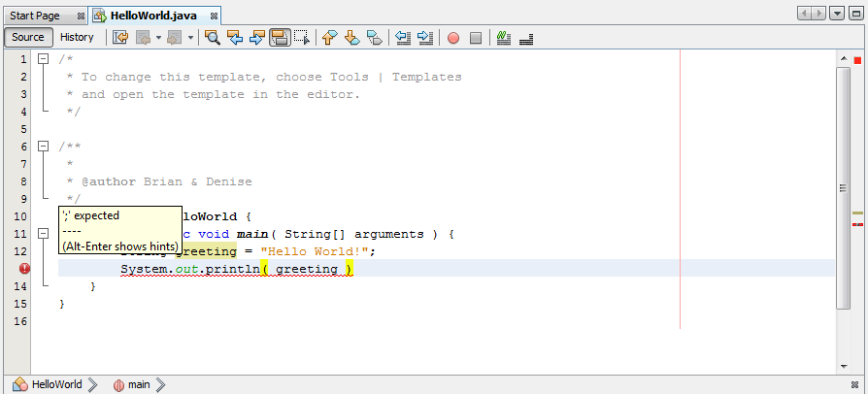
Fixing Errors
Error due to missing semicolon

Slide 11
Running a Java Program
Run > Run Project, or
Run button (green arrow), or
F6
Output displays in Output pane

Slide 12
Summary
Wrote our first program
Compile program
Run program

Slide 13
Homework
Read Chapter 3
Visit the websites mentioned in the text

